Slide 1
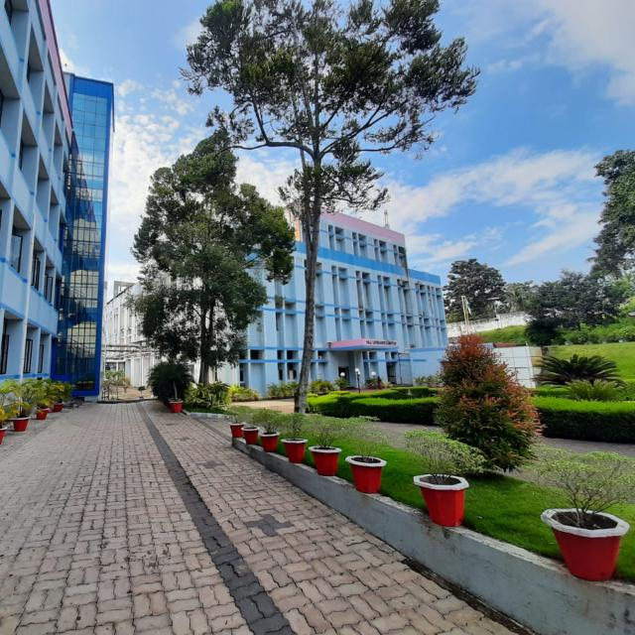
KERALA STATE ENERGY CONSERVATION AWARD – 2023
HLL LIFECARE LIMITED
AKKULAM FACTORY

Slide 2
OVERVIEW OF HLL AKKULAM FACTORY
Year of inception : 1992
Products : Blood Bags, Surgical Sutures, IUDs
Major Customers : MoH & FW, NACO,UNFPA, IDA,
Domestic trade & international market
Manufacturing Capacity
Blood Bags : 12.50 Million SBE
Surgical Sutures : 6.00 Lakh Dozens
Intra Uterine Device
  Copper T : 5.50 Million Pcs
  Tubal Ring : 2.50 Million Pairs

Slide 3


INTERNATIONAL QUALITY CERTIFICATIONS
Product Certification
CE Mark (blood bags)
as per Latest MDR Regulations- First in India
Facility Certifications
ISO 14001 :2015
ISO 45001 : 2018
ISO 13485 :2016
ISO 9001 :2015
UNFPA
Anvisa
IDA
Tanzania F& DA

Slide 4
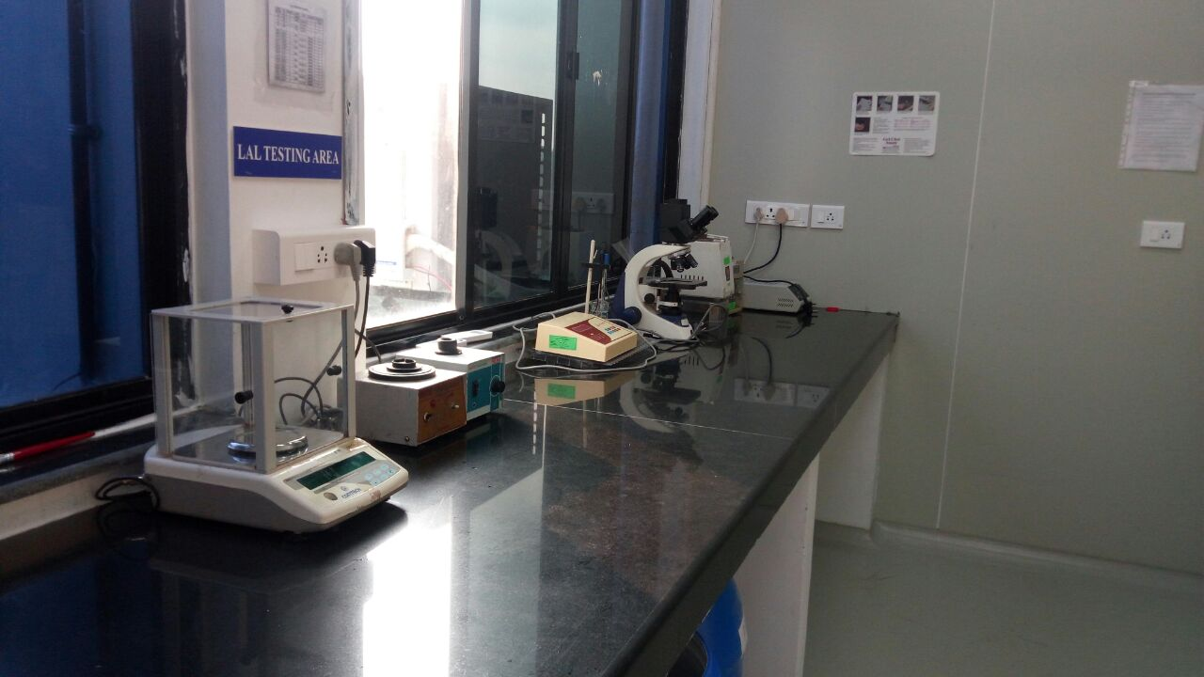
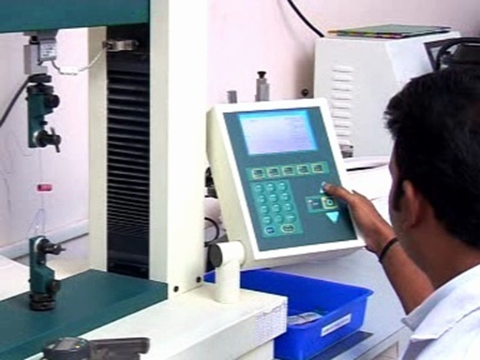
GMP/GLP Compliant
QA/QC labs
Physical & Chemical Testing Labs:
  Incoming raw & packing material tests
  In process test
  Final product test
Biological lab:
  Sterility & Pyrogen tests
  Bio burden tests

Slide 5


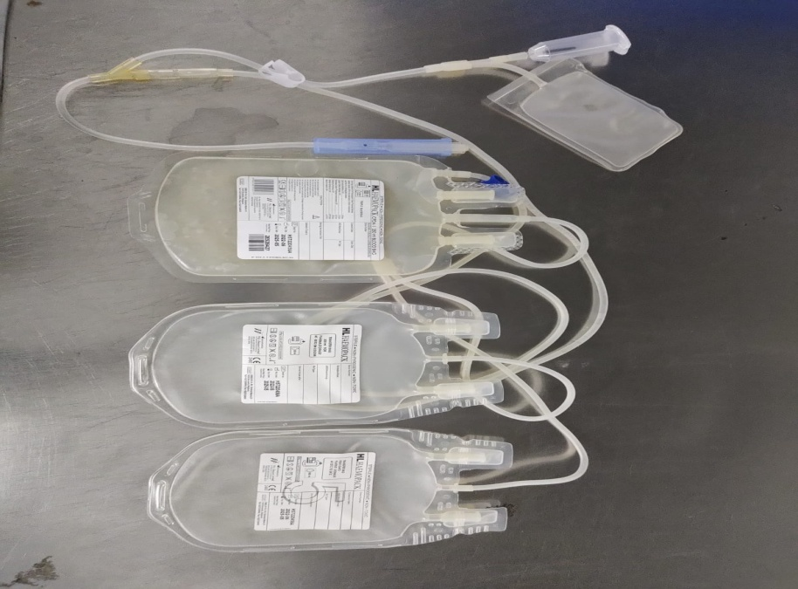
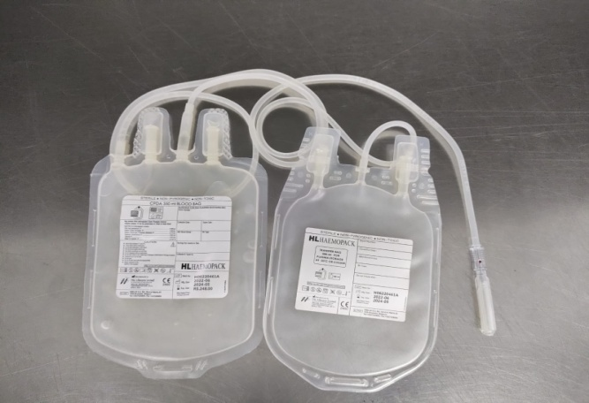
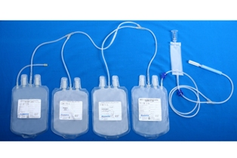
PRODUCTS
BLOOD BAGS
HL HAEMOPACK BLOOD BAGS
DONATO BLOOD BAGS
Blood Bags manufactured with highest adherence to quality and safety.
Available in a wide range of configurations to meet the modern-day needs of blood transfusion services.

Slide 6
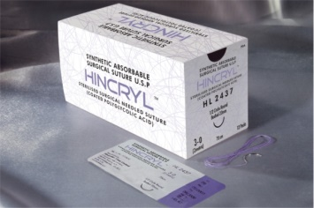
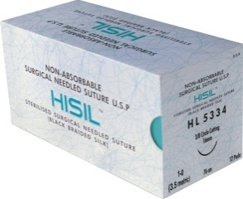
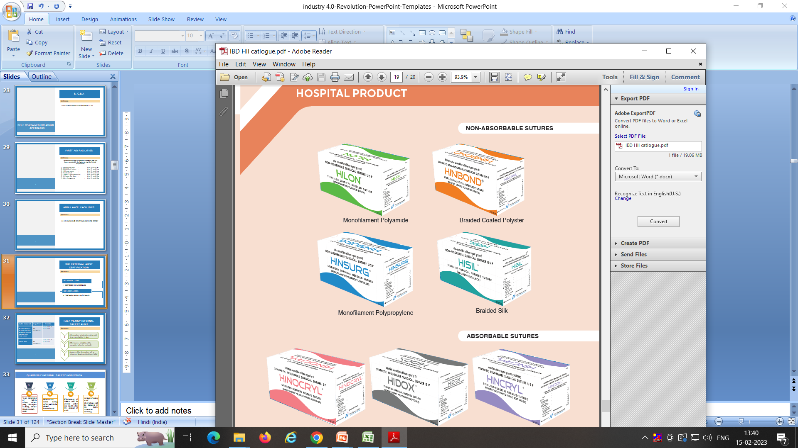
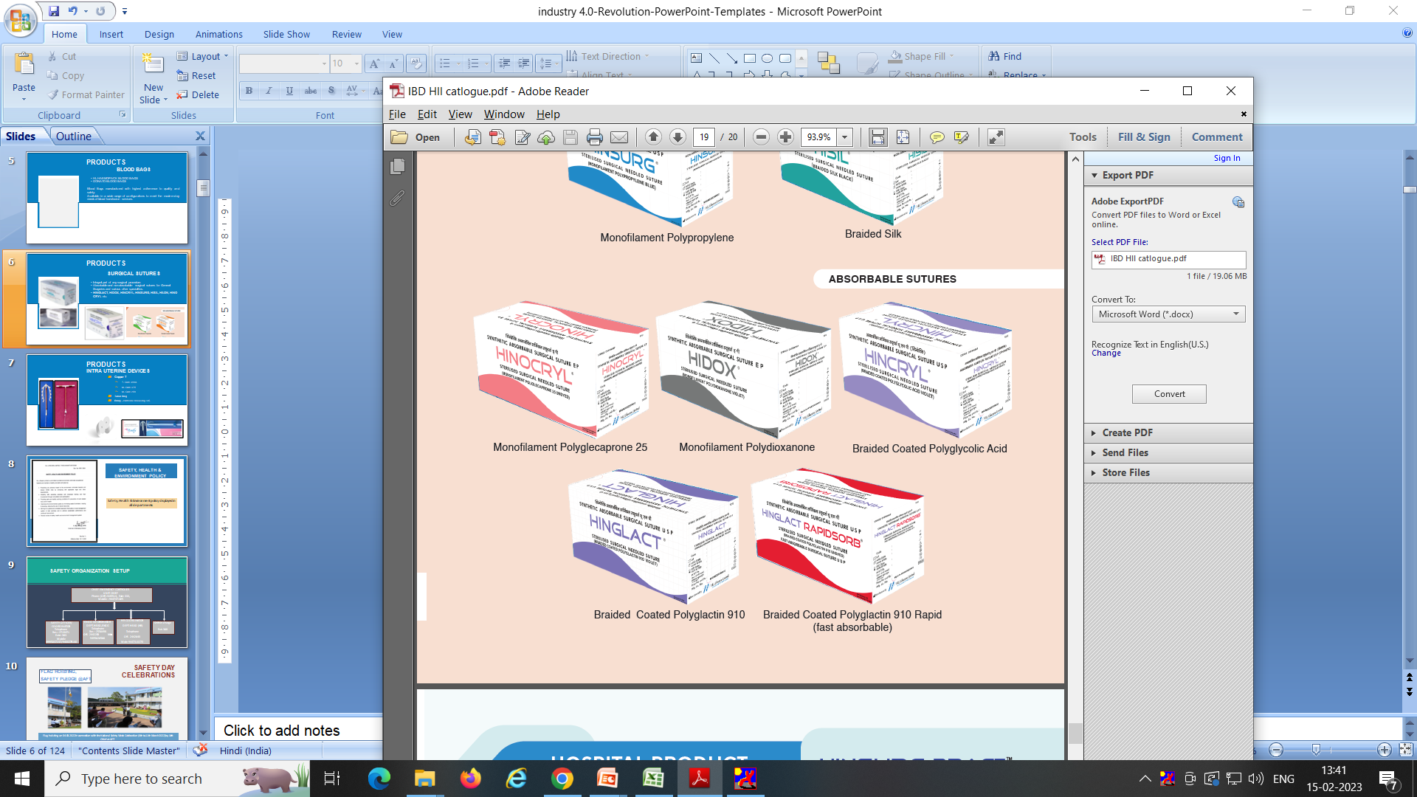
PRODUCTS
SURGICAL SUTURES
Integral part of any surgical procedure.
Absorbable and non-absorbable surgical sutures for General Surgeries and various other specialties.
HINGLACT, HIDOX, HINCRYL, HINSURG, HISIL,
HILON, HINOCRYL.

Slide 7

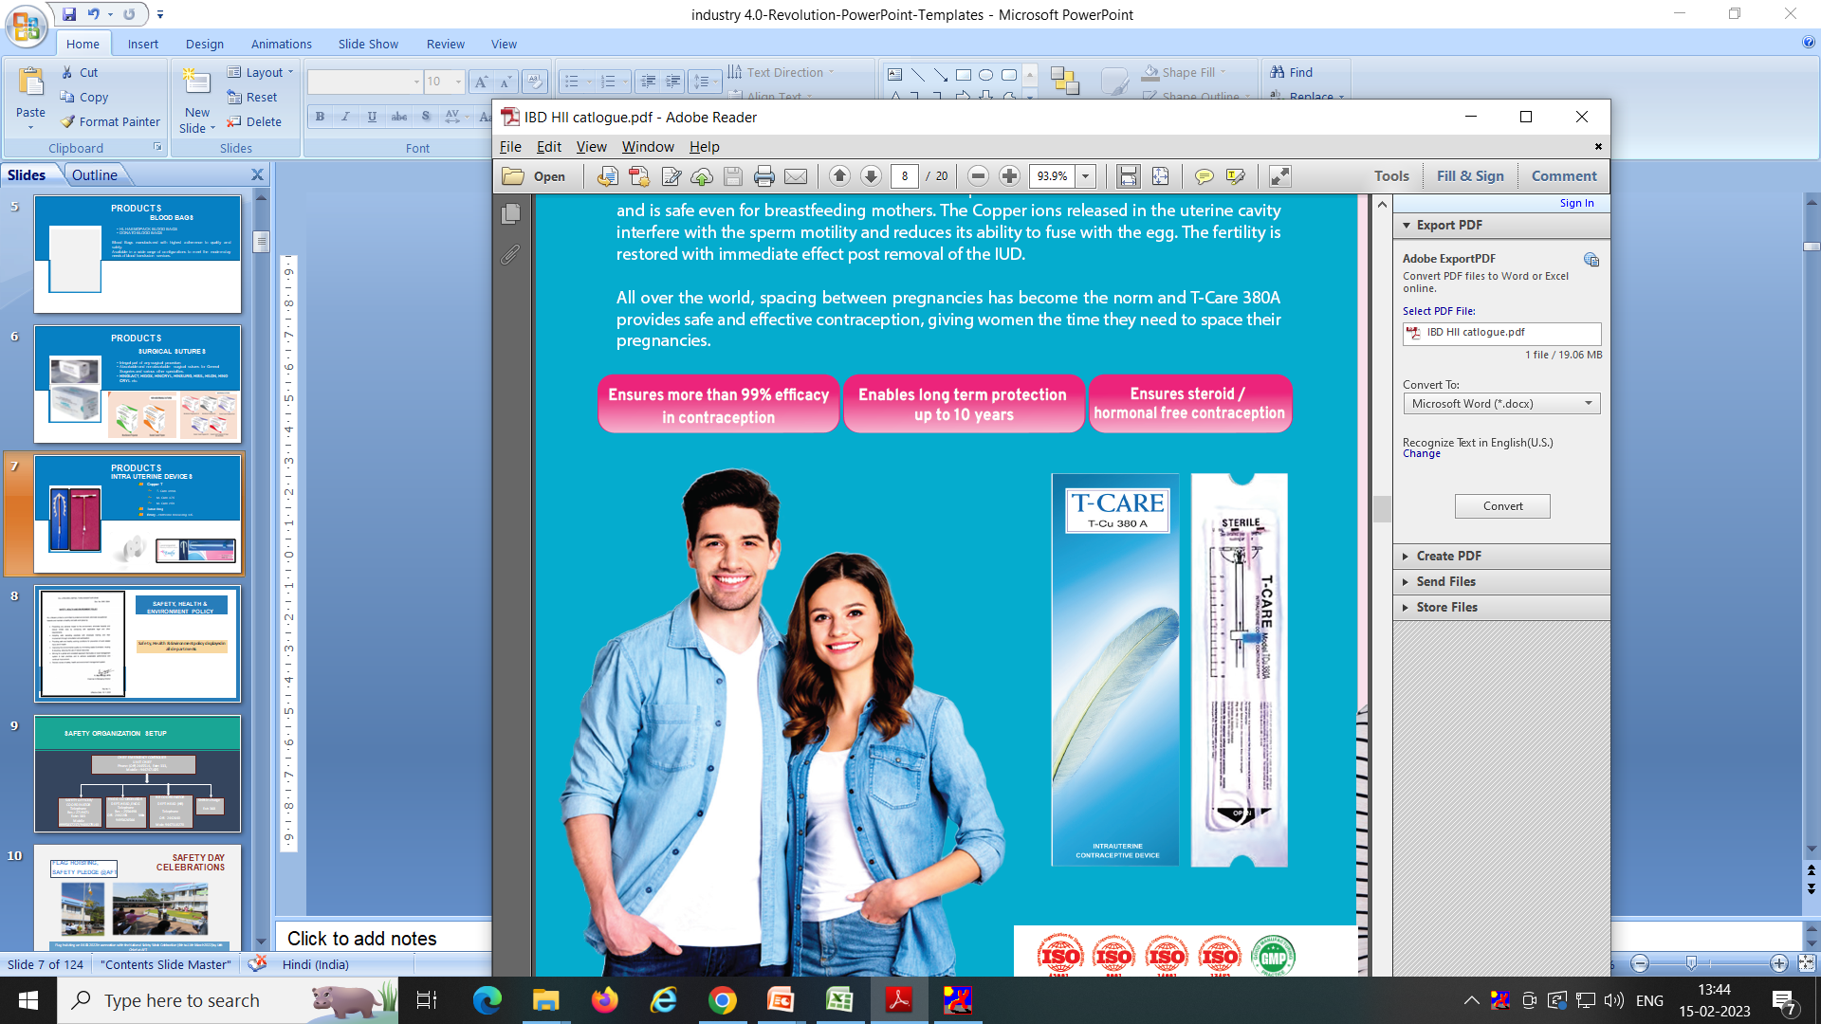
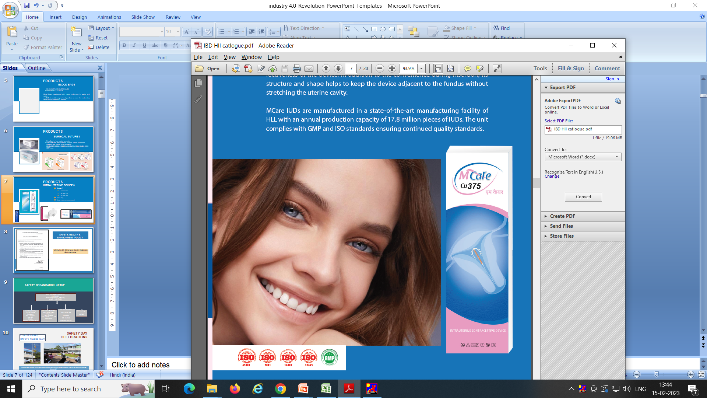
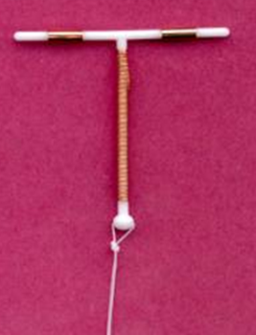
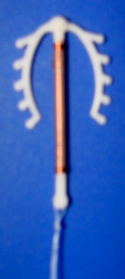
PRODUCTS
INTRA UTERINE DEVICES
Copper T
  T- Care 380A
  M- Care 375
  M- Care 250
Tubal Ring
Emily - Hormone releasing IUS

Slide 8
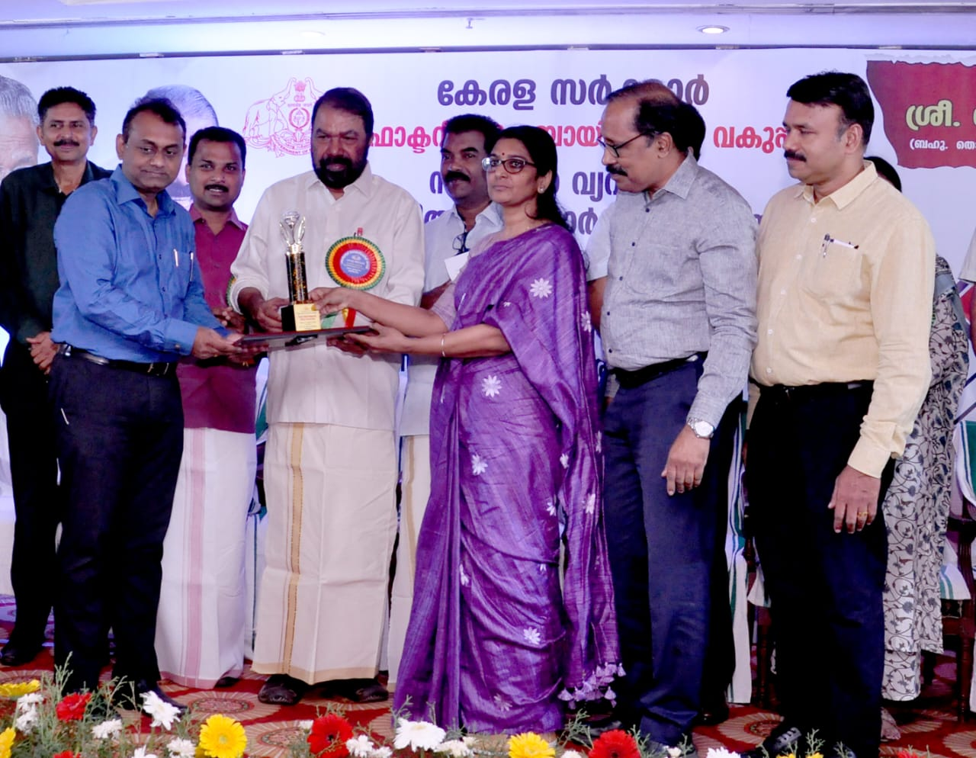
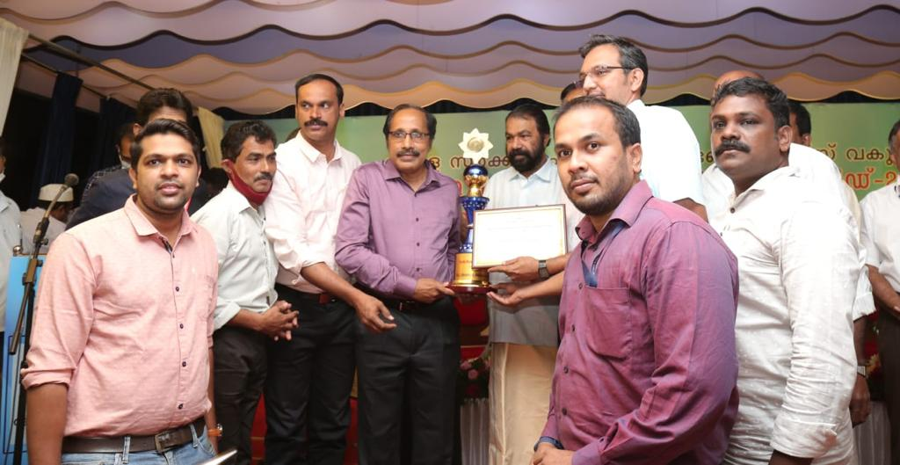
AWARDS & RECOGNITIONS
BEST SAFETY PERFORMANCE AWARD
HLL AFT received BEST SAFETY PERFORMANCE award in medium scale industries from Factories and Boilers, Govt. of Kerala, 2022
Best Safety Performance Award
2023
Awarded by Factories & Boilers GoK, for Medium Scale Industries

Slide 9
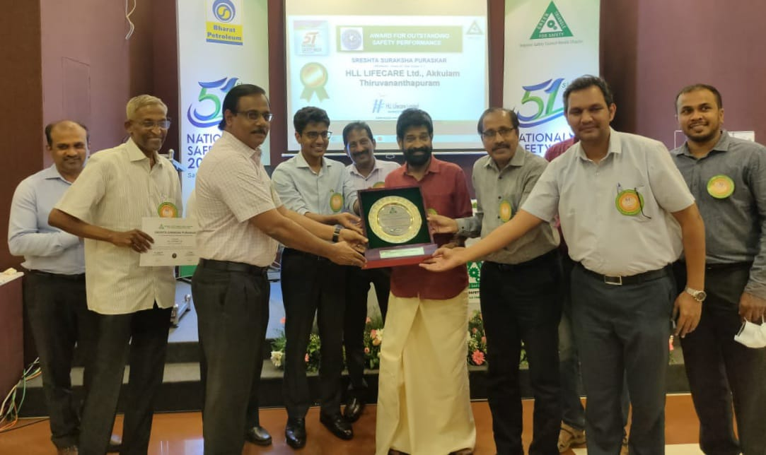
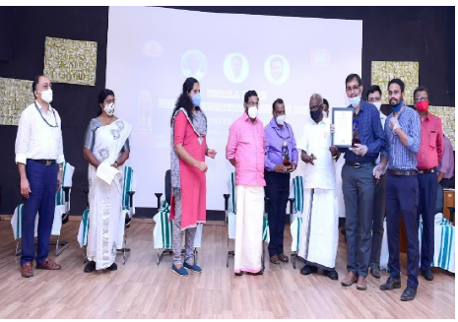
AWARDS & RECOGNITIONS
ENERGY CONSERVATION AWARD 2020
In medium scale category from EMC, GoK.
SRESTA SURAKSHA PURASKAR ARD
HLL AFT received the SRESTA SURAKSHA PURASKAR Award for outstanding safety performance in Medium Factories, in connection with the Industrial Safety Award – 2021 awarded by National Safety Council

Slide 10
MAJOR ENERGY CONSERVATION / GREEN ENERGY INITIATIVES
HLL Akkulam- Overview

Slide 11
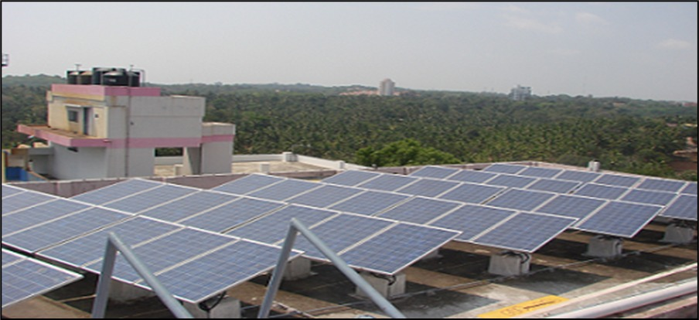
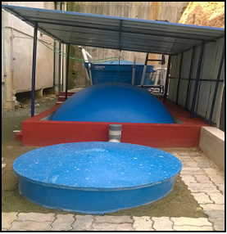
MAJOR ENERGY CONSERVATION INITIATIVES AT HLL AKKULAM FACTORY
Biogas Plant- 150 Kg/Day
25 kWp Solar Plant

Slide 12
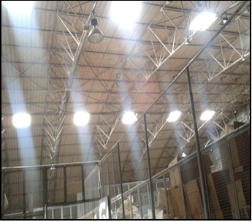
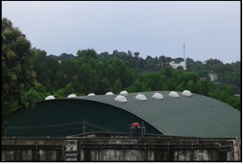
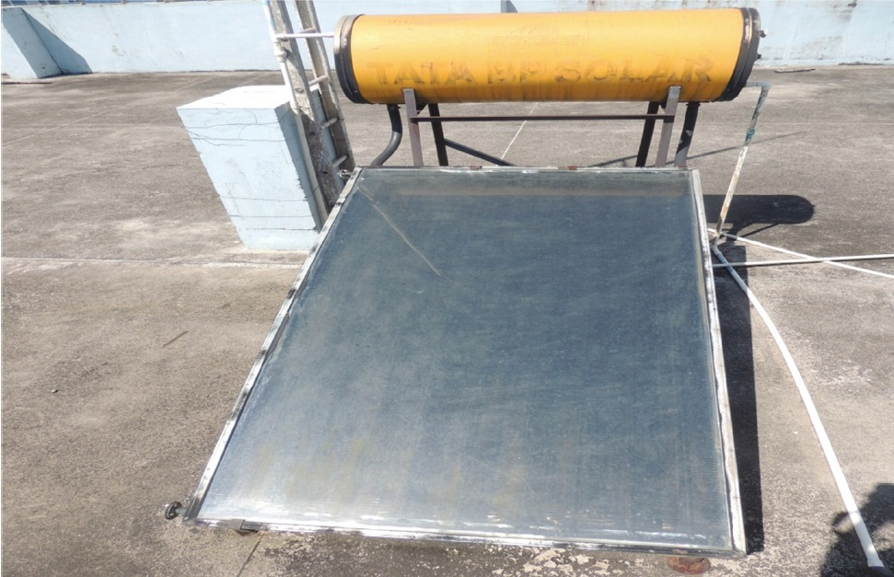
MAJOR ENERGY CONSERVATION INITIATIVES AT HLL AKKULAM FACTORY
Solar Water Heater- 100 Lph
Sky lighting at Storage Area
Avg. Lux level: 250

Slide 13
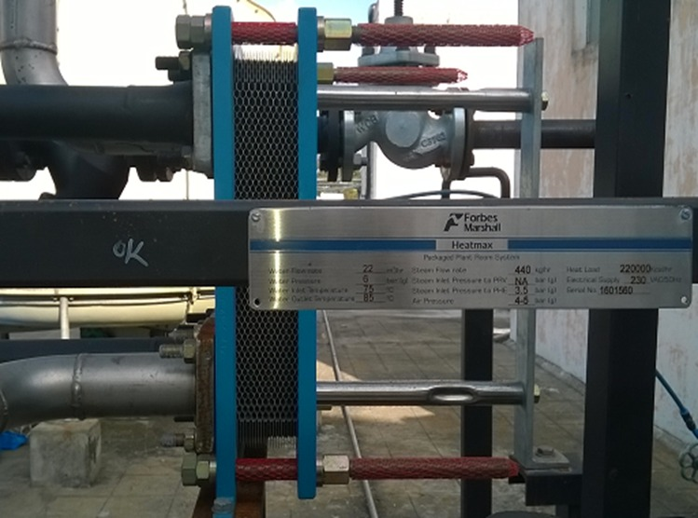
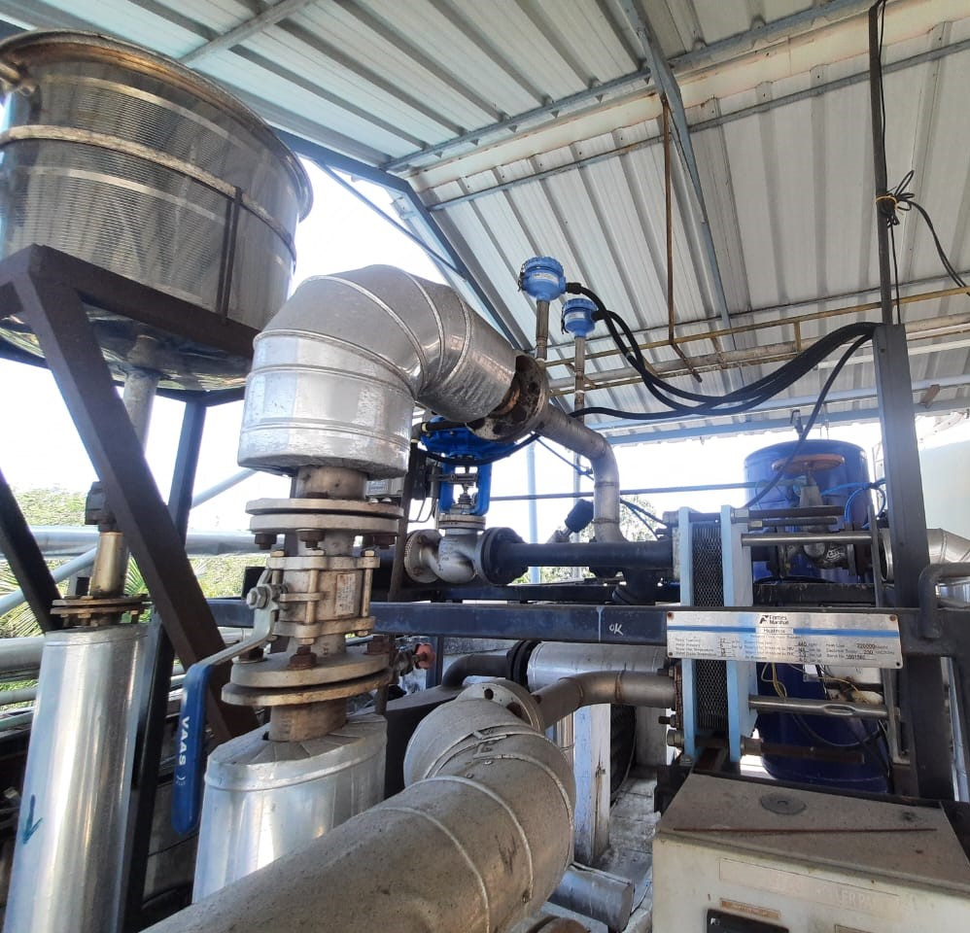
MAJOR ENERGY CONSERVATION INITIATIVES AT HLL AKKULAM FACTORY
Instantaneous Hot Water Generation unit

Slide 14
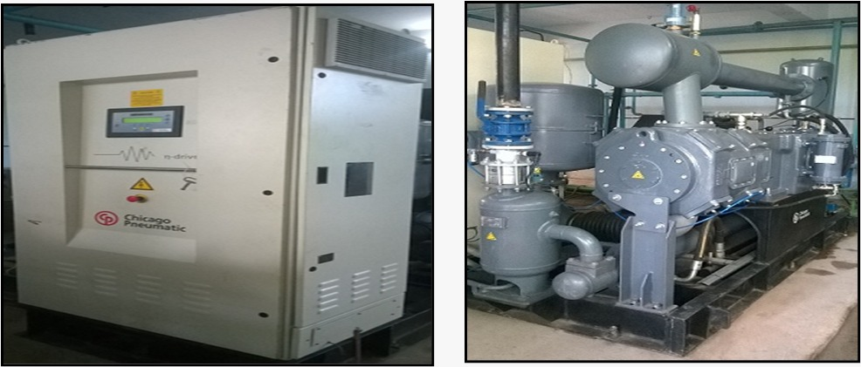
MAJOR ENERGY CONSERVATION INITIATIVES AT HLL AKKULAM FACTORY
VFD for 150 hp Air compressor

Slide 15
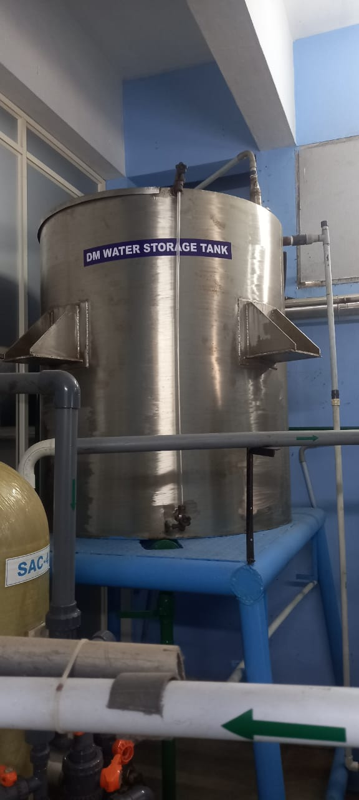
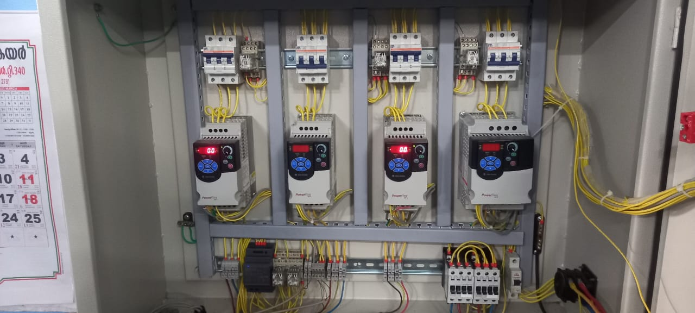
MAJOR ENERGY CONSERVATION INITIATIVES AT HLL AKKULAM FACTORY
Automatic Level Controller for DM plant

Slide 16
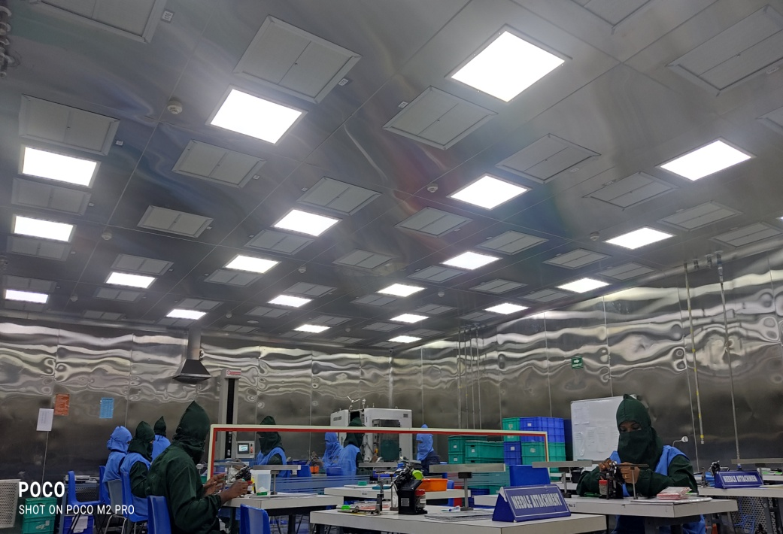
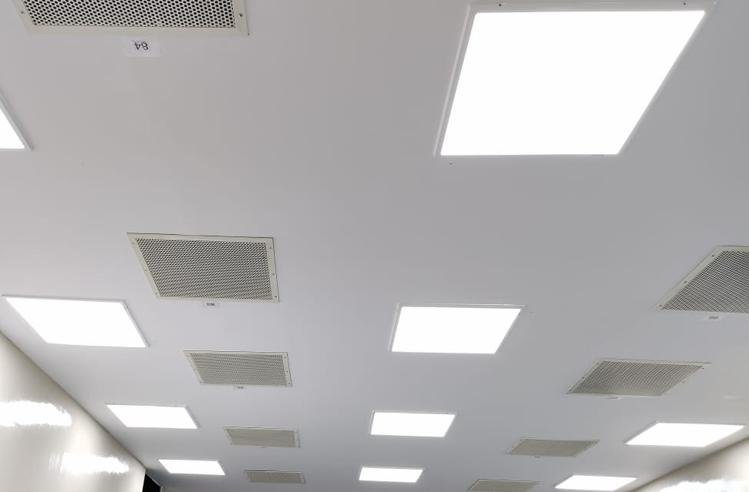
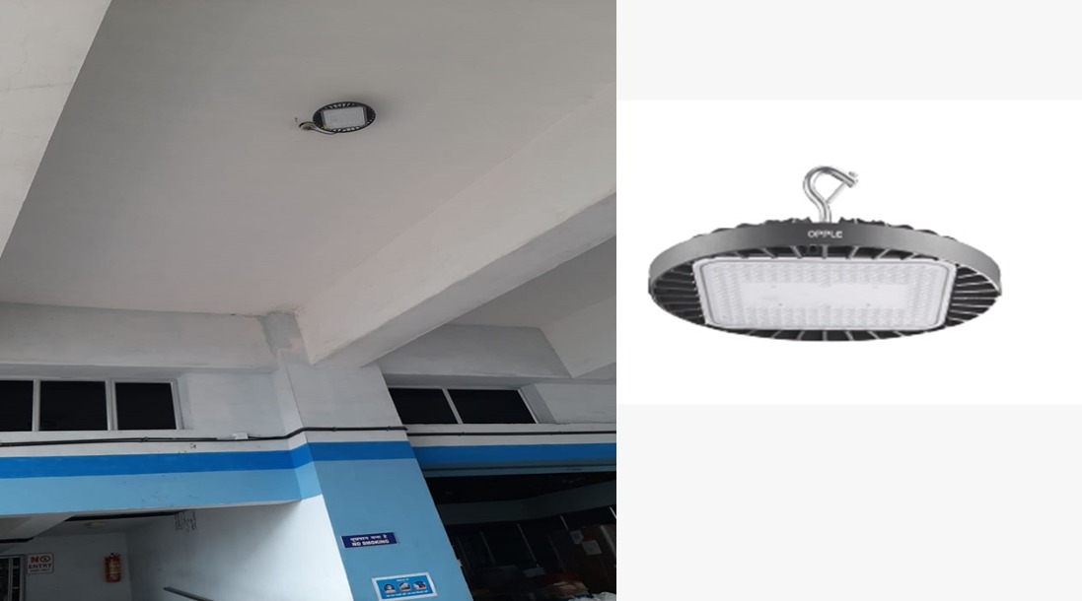
MAJOR ENERGY CONSERVATION INITIATIVES AT HLL AKKULAM FACTORY
Energy Efficient Lighting

Slide 17
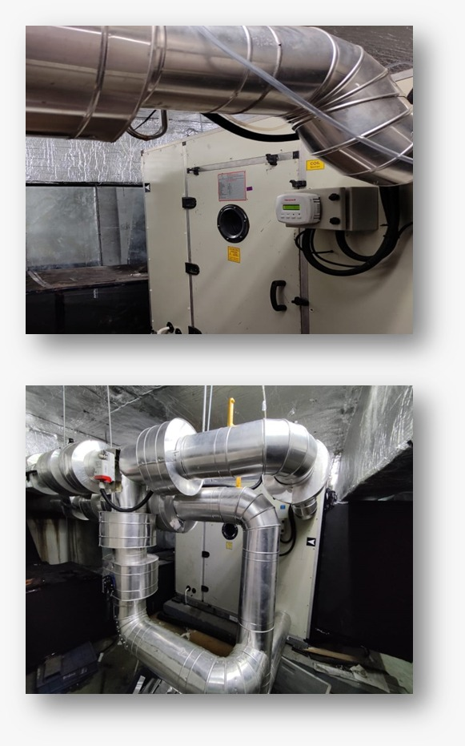
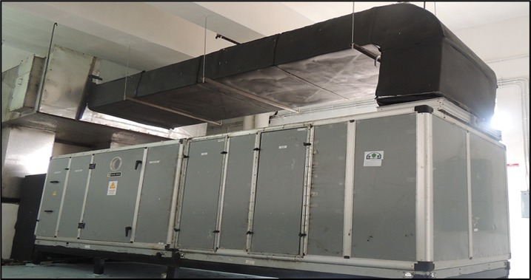
MAJOR ENERGY CONSERVATION INITIATIVES AT HLL AKKULAM FACTORY
Energy efficient Double skin AHUs for clean room

Slide 18
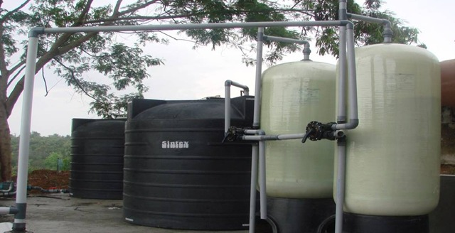
MAJOR ENERGY CONSERVATION INITIATIVES AT HLL AKKULAM FACTORY
130 kL capacity Rainwater harvesting system

Slide 19
MAJOR ENERGY CONSERVATION ACTIVITIES, SAVINGS & INVESTMENTS -2022-23

Slide 20
IMPLEMENTATION OF ADVANCED ENERGY MONITORING SYSTEM
System aids in live monitoring of the energy consumption of all electrical installations including production and utility equipment at HLL Akkulam Factory.
Timely corrective and preventive measures to control and optimize energy consumption.
Product wise actual energy consumption can be obtained instead of estimations .
Total investment | Rs.9.00 LAKH
First year energy cost savings | Rs.8.90 LAKH

Slide 21
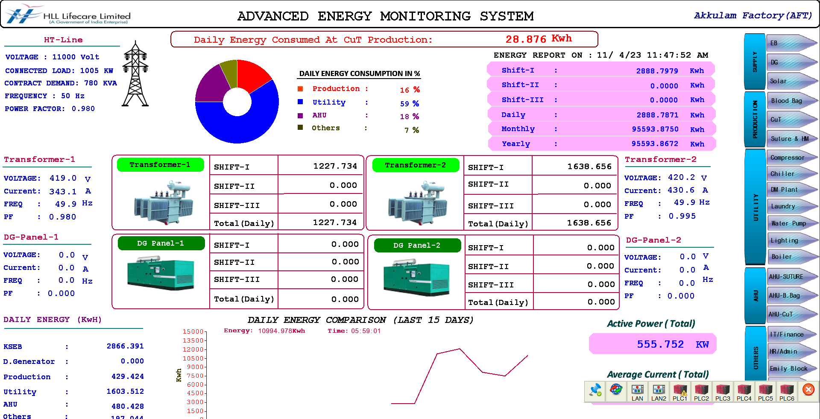
IMPLEMENTATION OF ADVANCED ENERGY MONITORING SYSTEM
HOME PAGE

Slide 22
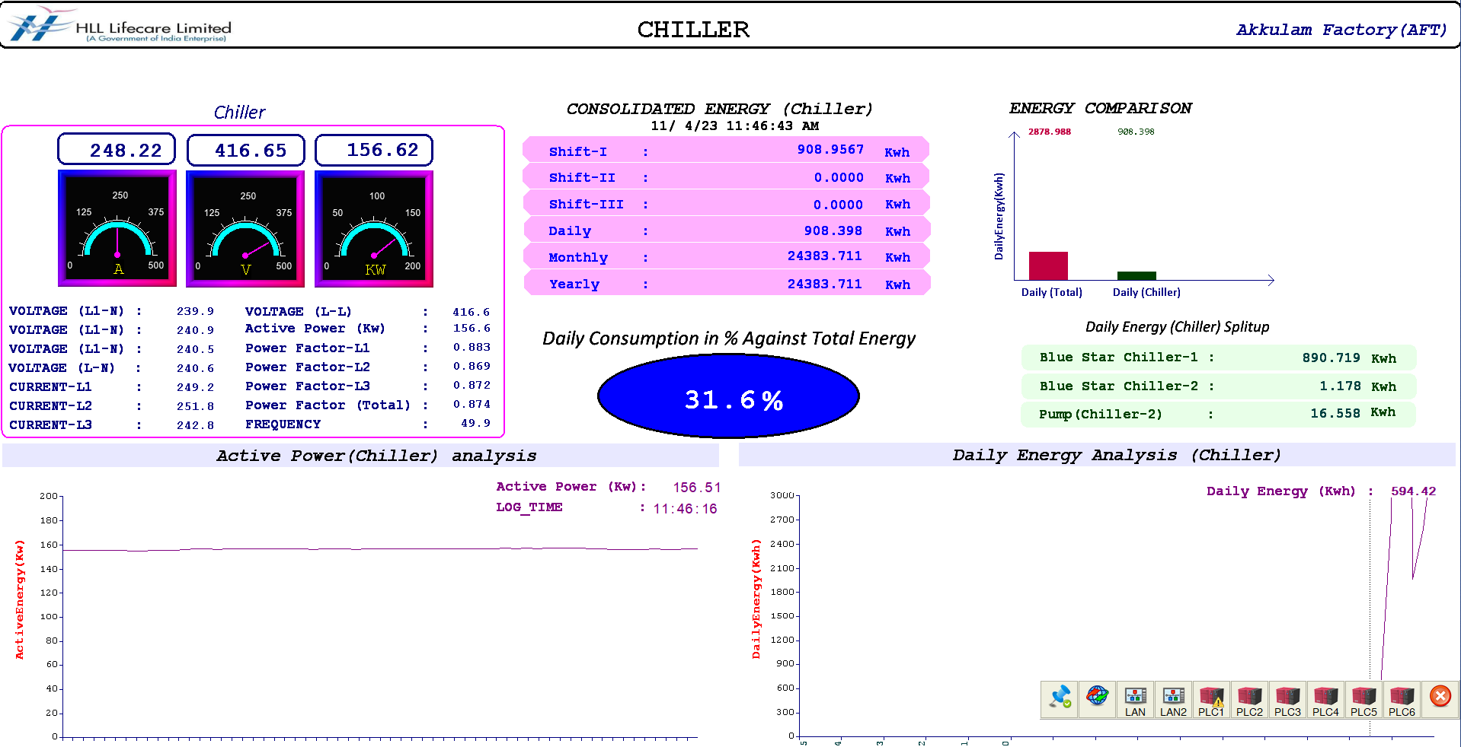
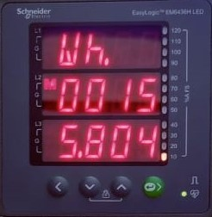
IMPLEMENTATION OF ADVANCED ENERGY MONITORING SYSTEM
Advanced energy meters installed at all electrical panels of the factory.
Data from all energy meters are synched with the EMS system in real-time.
Data is being presented in a user-friendly manner in dashboard formats and reports.

Slide 23
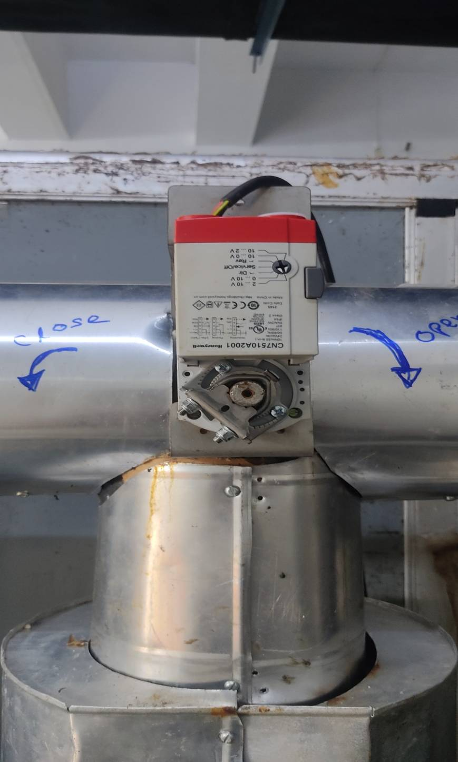
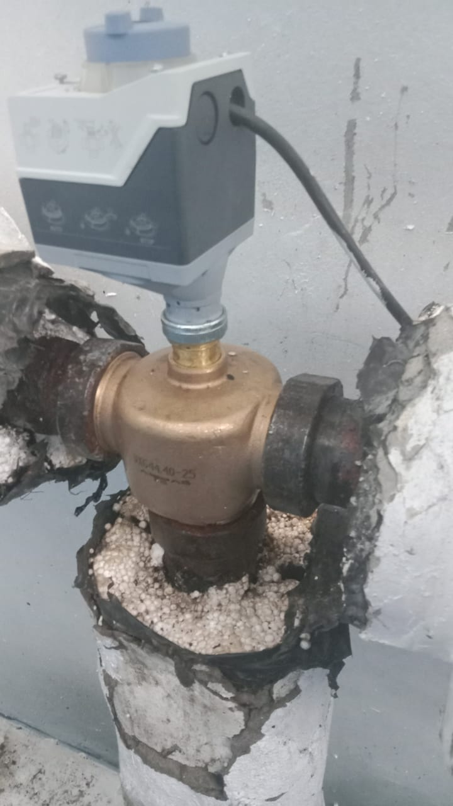
INSTALLATION OF ELECTRICALLY ACTUATED VALVES IN AHUS
Installed Electrically actuated valves to control the chilled water supply in all AHUs in Blood Bag, Cu T and Suture production.
Total investment | Rs 2.5 LAKH
First year energy cost savings | Rs. 1.55 LAKH

Slide 24
INSTALLATION OF FEEDBACK CONTROL MECHANISM IN AHUs
Installed temperature transmitters in return air duct of AHU’s and based on return air temperature speed of AHU’s varied.
AHU’s speed optimized based on actual load requirement.
Total investment | Rs.1.5 LAKH
First year energy cost savings | Rs. 4.96 LAKH

Slide 25
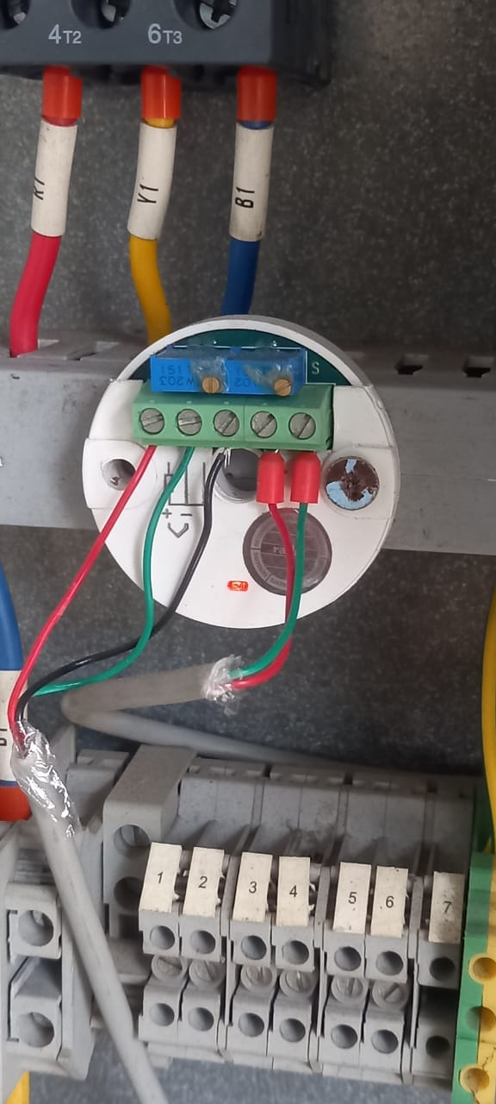
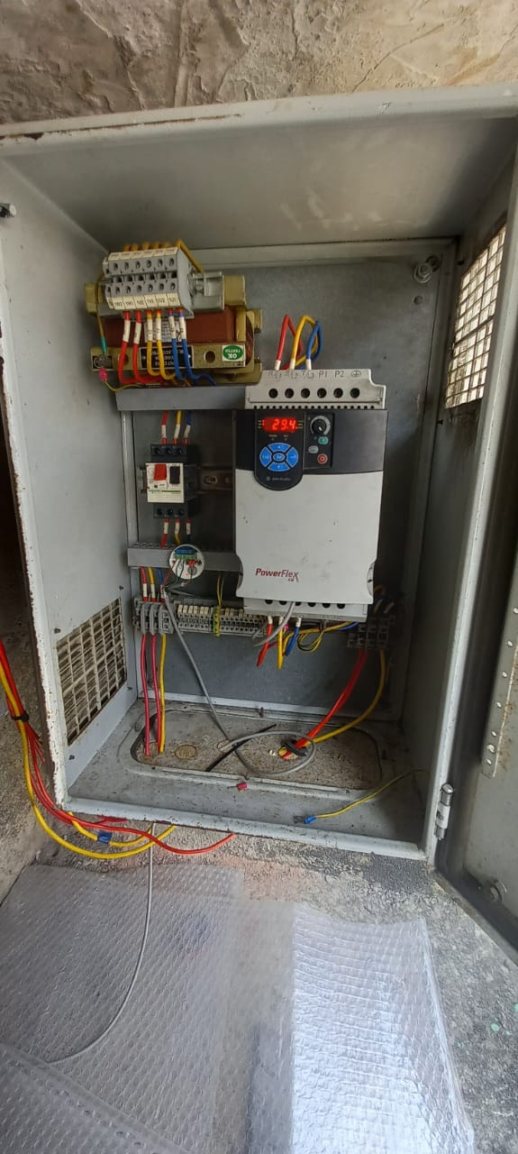
INSTALLATION OF VFD IN COOLING
TOWER PROCESSING
VFD provided in the cooling tower used for process application. Reduction in energy consumption by 17160 KWH per annum.
Total investment | Rs. 0.75 LAKH
First year energy cost savings | Rs.1.15 LAKH

Slide 26
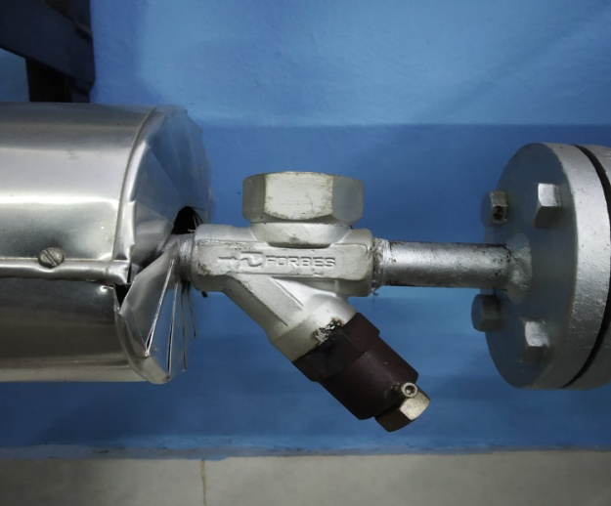
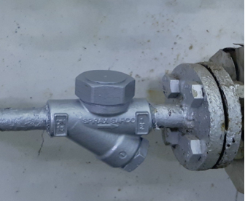
MODIFICATION OF CONDENSATE RECOVERY SYSTEM
Condensate recovery system modified by adding Steam traps (TD -13 nos.) in steam consumption areas.
Total investment | Rs. 4.2 LAKH
First year energy cost savings | Rs. 10.74 LAKH

Slide 27
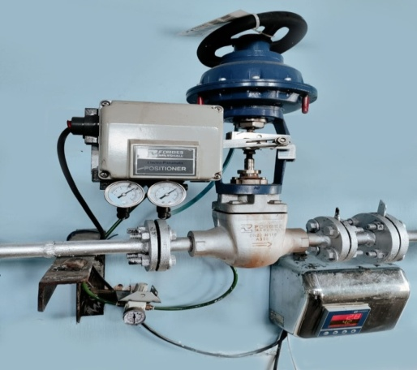
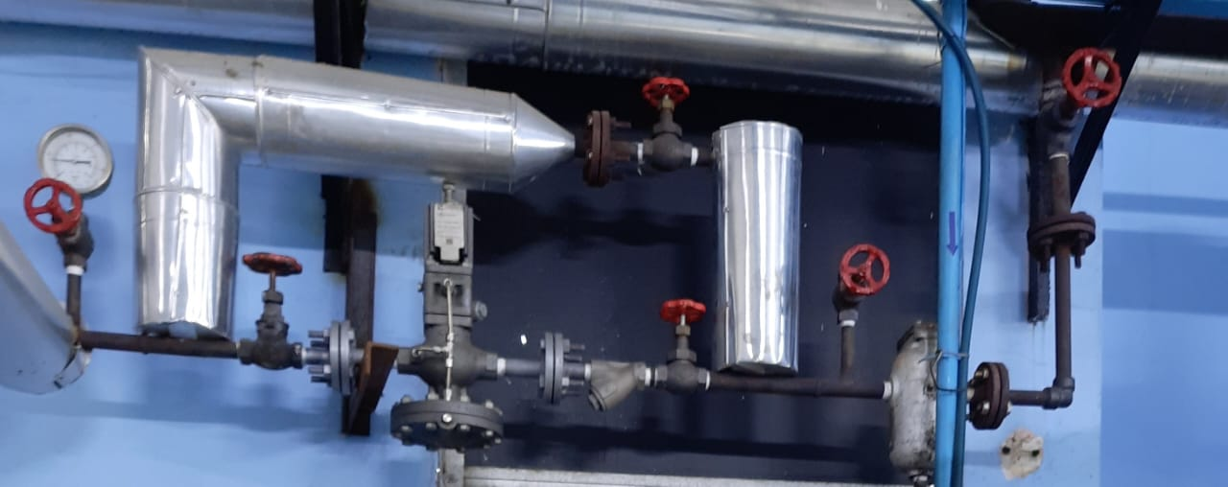
INSTALLATION OF PRESSURE REDUCING VALVE SYSTEM FOR STEAM PRESSURE OPTIMIZATION
Installed PRV System for steam pressure optimization in NCG tank for Pure Steam Generator, AHU’s for Suture Clean room RH Control and Canteen.
Total investment | Rs. 5.4 LAKH
First year energy cost savings | Rs. 5.2 LAKH

Slide 28
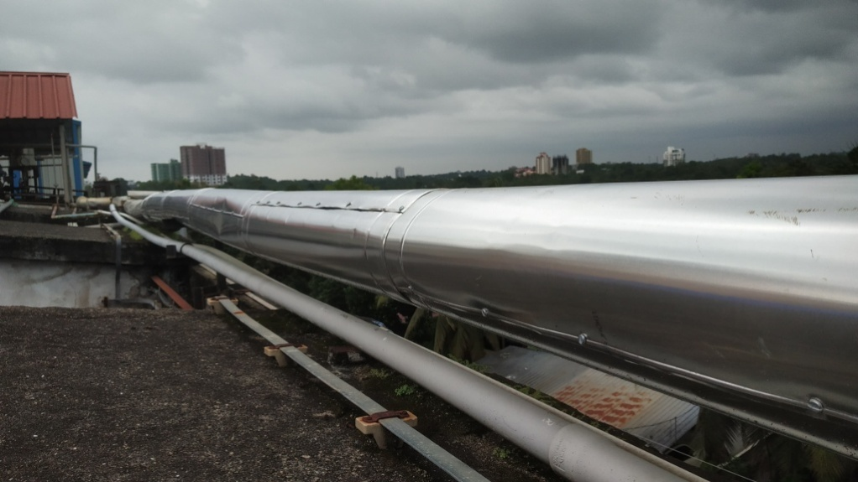
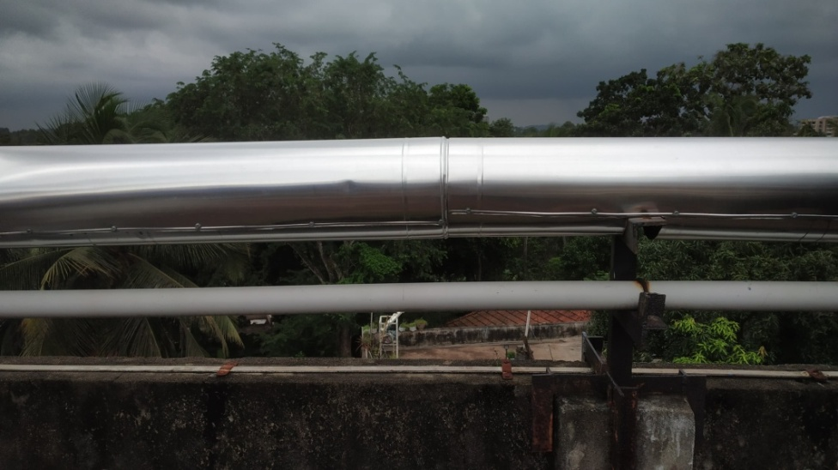
HOT INSULATION PROVIDED IN UTILITY LINES
HOT INSULATION PROVIDED IN UTILITY LINES
Reinsulation of old steam lines carried out (200 m). It resulted in 1.08 % reduction in Furnace oil consumption
Total investment | Rs. 1.55 LAKH
First year energy cost savings | Rs.2.06 LAKH

Slide 29
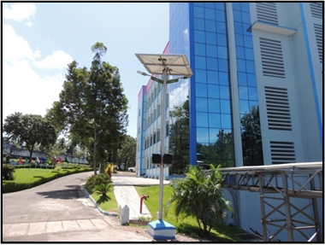
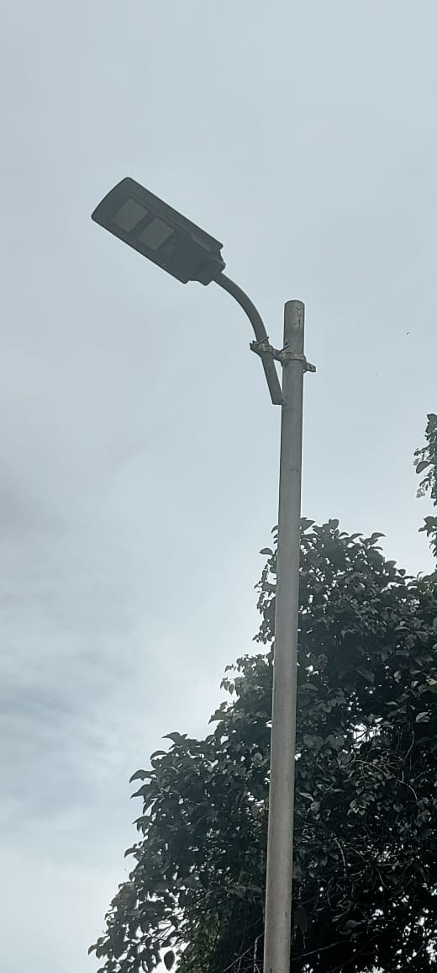
HOT INSULATION PROVIDED IN UTILITY LINES
INSTALLATION OF INTEGRATED SOLAR STREET LIGHTS
Installation of 10 numbers of 40 W integrated solar street lights with motion sensor. The light will work at 20 W normally and change to 40 W once it senses some motion.
Total investment | Rs. 2.0 LAKH
First year energy cost savings | Rs.0.15 LAKH

Slide 30
ENERGY CONSERVATION ACTIVITIES SNAP SHOT : 2022-23
Sl No | Description | Investment (Lakh) | Savings in First year (Lakh)
1 | Implementation of Advanced Energy Monitoring System | 9.0 | 8.9
2 | Installation of Pressure Reducing Valve (PRV) System at NCG tank at Pure Steam Generator, Dehumidifier and Canteen. | 5.4 | 5.2
3 | Installation of 3 way valves in Air Handling Units (AHU) | 2.5 | 1.55
4 | Modification of condensate recovery system | 2.08 | 10.74
5 | Hot insulation provided in Utility Lines | 1.55 | 2.06
6 | Installation of feedback control mechanism in AHU | 1.5 | 4.96
7 | Installation of VFD for Fan of 200TR Processing Cooling Tower | 0.75 | 1.15
8 | Installation of 10 nos of integrated solar street lights | 2.0 | 0.15
 | Grand Total | 24.78 | 34.71
Notes:
DESCENDING ORDER OF INVESTMENT

Slide 31
Consumption Analysis 2022-23
Water Consumption (kL)
FO Consumption (L)
Electricity Consumption (KWh)
Savings of Rs. 9.10 Lakh by reducing consumption by 14.51%
Savings of Rs. 9.58 Lakh by reducing consumption by 12.52%
Savings of Rs. 0.99 Lakh by reducing consumption by 14.97%.
Production | Blood bag (SBE) | Suture (Dozen) | Copper T (MPcs)
2022-23 Q1 to Q3 (Average) | 28,74,207 | 21,625 | 1.91
2022-23 Q4 | 26,96,687 | 25,945 | 2.55

Slide 32
Savings of Rs. 39.59 Lakh by reducing consumption by 23.43%
Savings of Rs. 28.03 Lakh by reducing consumption by 12.20%
Savings of Rs. 7.06 Lakh by reducing consumption by 34.97%.
Production | Blood bag (SBE) | Suture (Dozen) | Copper T (MPcs)
2023-24 (Apr to Dec) | 82,81,018 | 80,835 | 4.56
2022-23 (Apr-Dec) | 86,22,621 | 64,877 | 5.72

Slide 33
TRAININGS & KNOWLEDGE SHARING SESSIONS

Slide 34
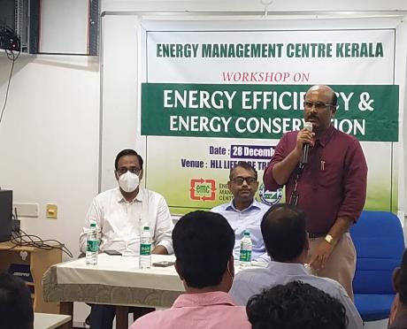

SAFE FORUM ACTIVITIES
Tech fix Forum of Engineering department arranged a knowledge sharing session on the topic “Energy conservation measures”
Tech Fix Safe Forum

Slide 35

STEAM AND STEAM SYSTEM -
TRAINING PROGRAM
Awareness and knowledge sharing program by engaging OEM (M/s Forbes Marshall) to engineering technicians

Slide 36
THANK YOU

